Slide 2
Recurrent Model of Brain Activity Based on the Markov Chain in the Time Domain
19.03.2022

Slide 3
Content:
About MEG
Problem
Modelling
Results
Conclusion

Slide 4
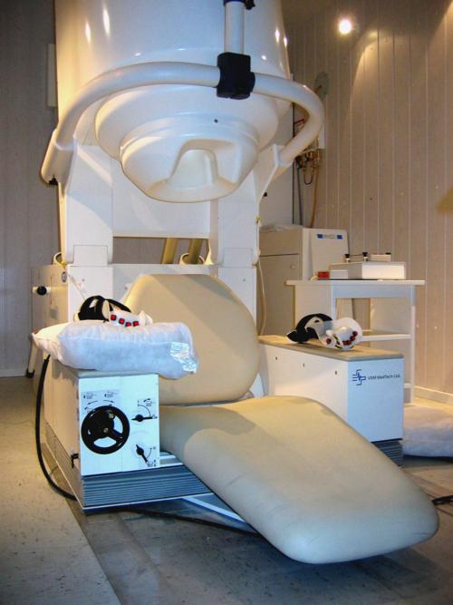
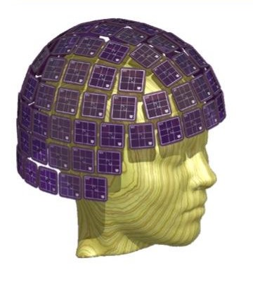
About MEG
http://ilabs.uw.edu/what-magnetoencephalography-meg/

Slide 5
Problem
It is required to propose a Markov stochastic model of the
spatiotemporal sequence of dipole excitations, in which the
probability of excitation of a particular dipole at the k-th cycle
is proportional to the spatial proximity to the excited dipoles
at the (k-1)-th cycle.

Slide 6
Modelling
R = 5mm
nk= 1 (∀ k)
kmax = ∞
Ndip = 15002
With a probability of 0.9, the dipole signal does not stop and has nk excited.
No noise generation was performed for the signal.

Slide 7
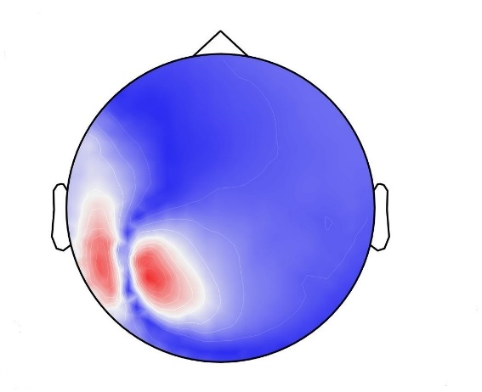
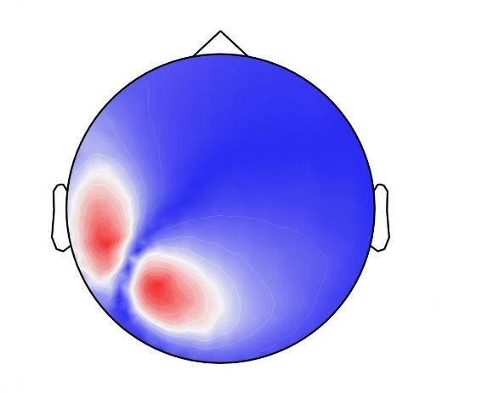
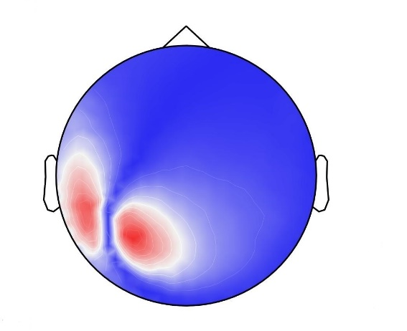
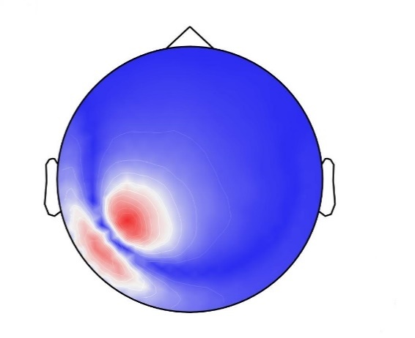
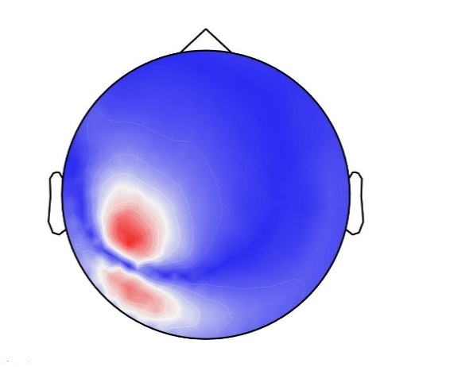
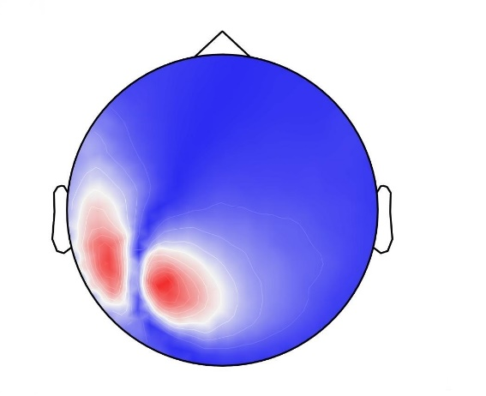
Results
Averaged magnetic field at the first step.
Averaged magnetic field at the second step
Averaged magnetic field at the third step.
Averaged magnetic field at the fourth step
Averaged magnetic field at the fifth step
Averaged magnetic field at the sixth step

Slide 8
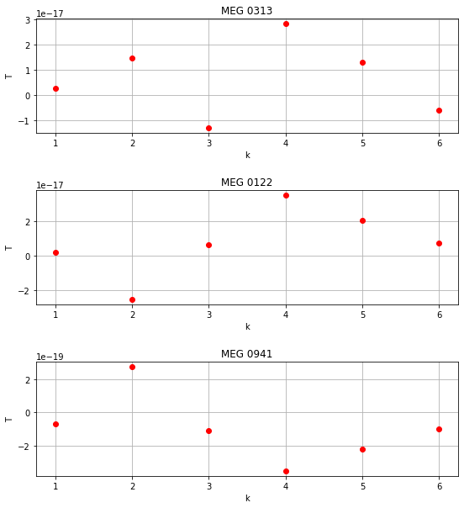
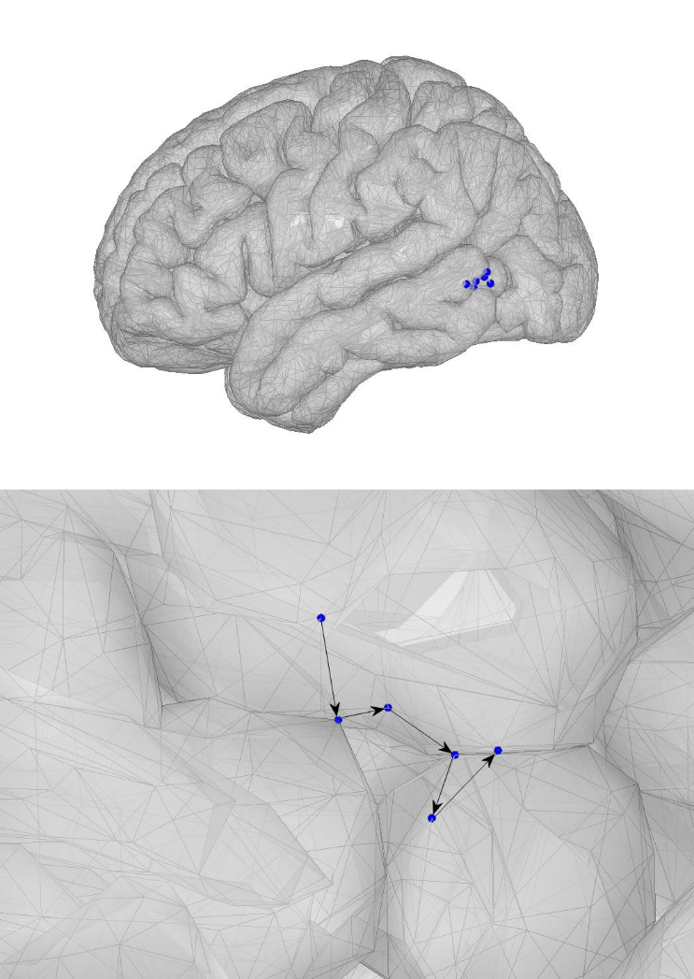
Results
The sequence of observed averaged fields on a discrete clock cycle – individual sensors.
The sequence of excited dipoles on the surface of the brain

Slide 9
Conclusion
A stochastic Markov model of brain activity is proposed, taking into account the hypothetical spatiotemporal correlation of the excitation of dipoles.
Further research on the topic is devoted to creating a dataset and solving the inverse problem using machine learning methods based on the proposed model.

